Slide 1
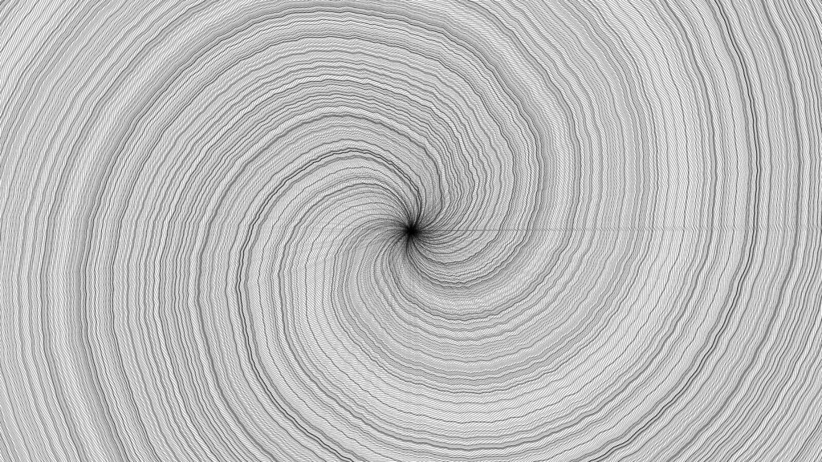
Generative Computer Designs
Dairy / Dokumentation
Marco Hartmann
23.09.2020 - 09.10.2020

Slide 2
23.09.2020 - Introduction and Project start
First on the list was getting the P5js running on Visual Code.
After that, I started with following the Document given to us.
I looked at some Shapes and how you can interact with them.
But after some analysing of the codes, I got stuck on the vector movement. I made it my target for the day to make a moving Object that moves "natural".
So far I was not able to archive that. They look funny do.

Slide 3
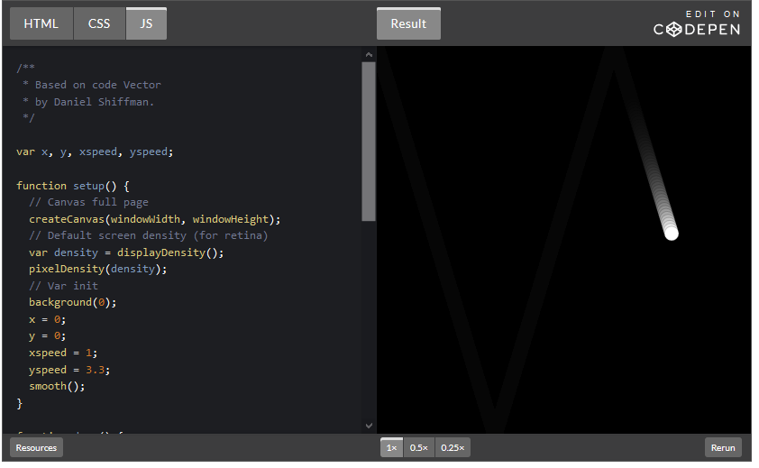
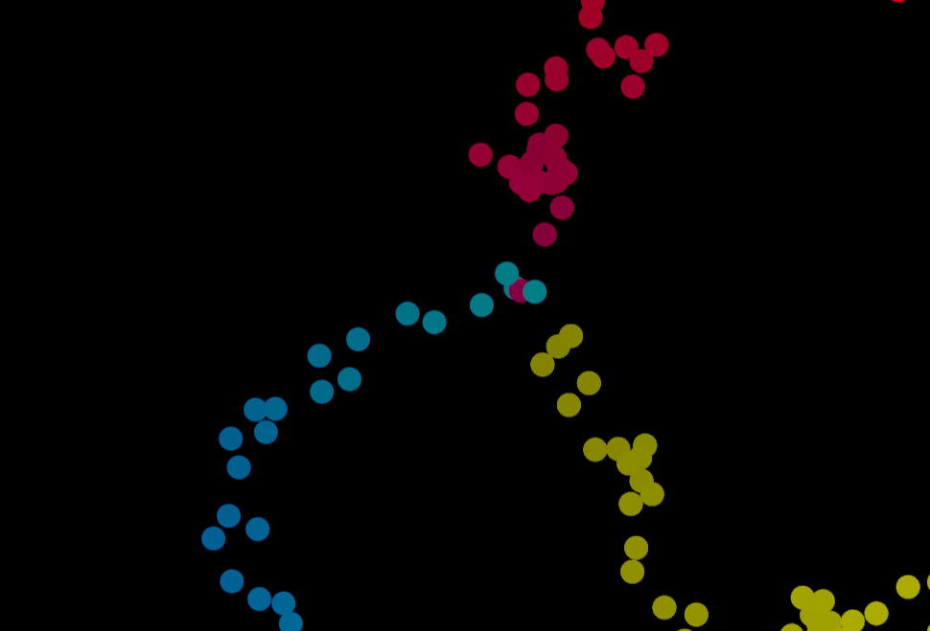
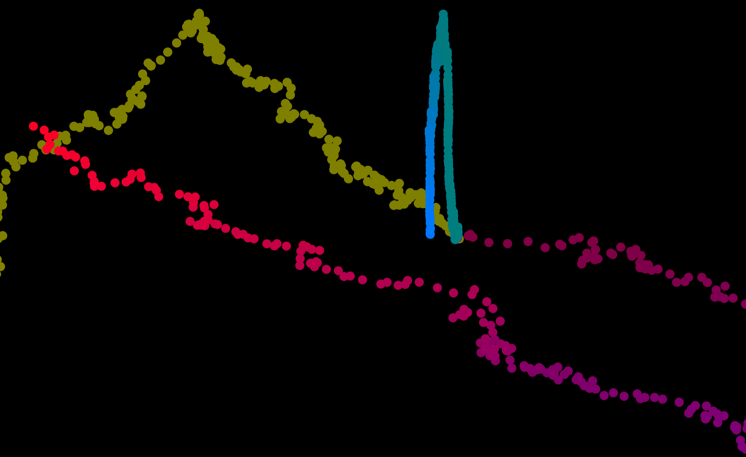
Evolution of my vector movment.
Above is the Original one and the other two are with 3 individual balls moving around.

Slide 4
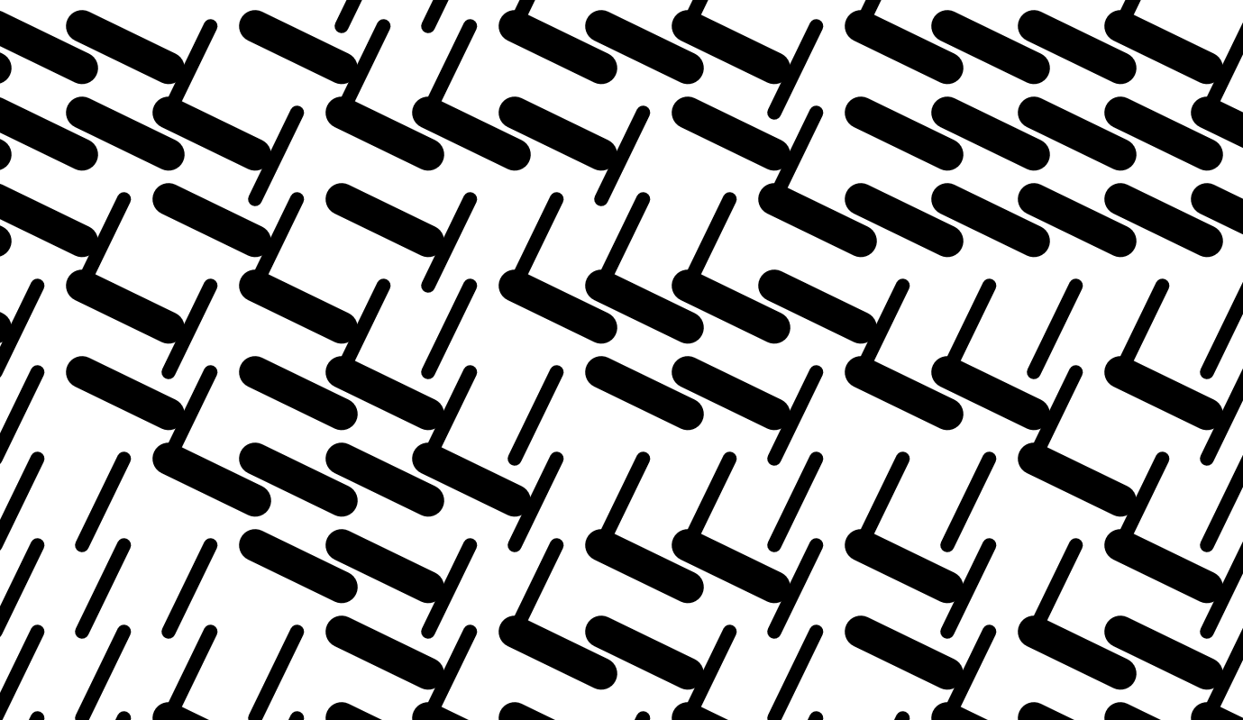
24.09.2020 - Grid and Squares
On the second day, I focused on creating a Gridpattern and putting my own Shape into those. I studied some of the examples in the Book "Generative Gestaltung" and tried them out to imitate.
After multiple attempts, I was able to create a standard code Pattern who works with mouse input like one of the references from the P5 library.

Slide 5
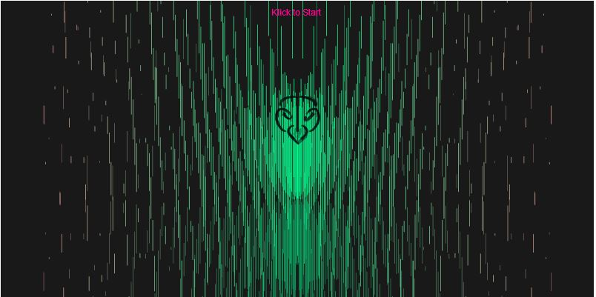
25.09.2020 - Music and Drawings Sound01/02
In a previous Project (codingtrain1) I already worked with sound. I was pleased with the visualisation I archived in that Project. So I wanted to improve on working with sound and see what I can create with them. https://editor.p5js.org/SirDragon001/full/D6GIvDTMh

Slide 6
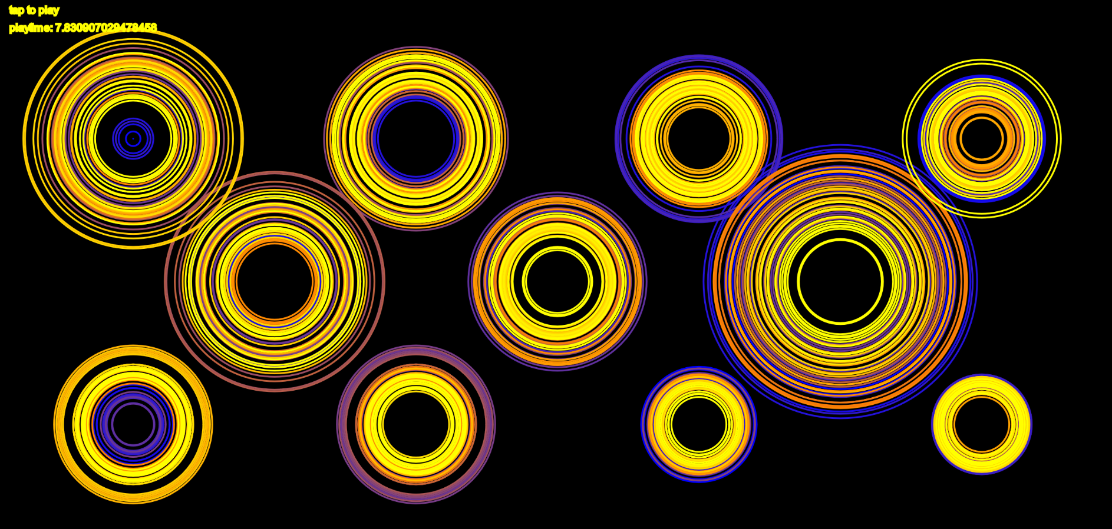
I made different circles responding to different frequencies. The most annoying part was to arrange and size them to not interfere with each other. I manualy spaced them with testing, resizing and moving around.

Slide 7
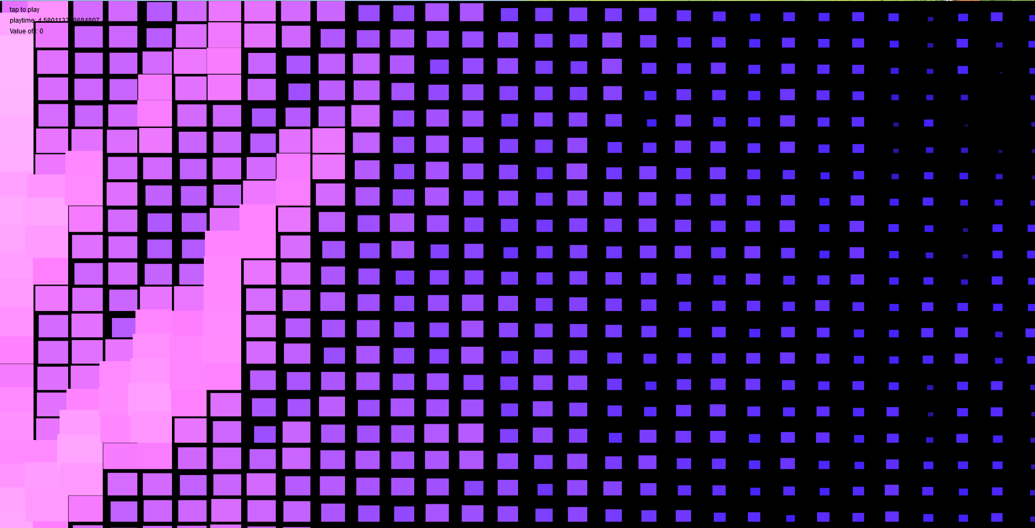
I combined the sound circles and the grid pattern from my two previous works. I changed the forms from circles to squares and made them respond not just in size with the music, but also with colour.
strokeCap(actStrokeCap);
randomSeed(actRandomSeed);
for (let gridX = 0; gridX < tileCount; gridX++) {
for (let gridY = 0; gridY < tileCount; gridY++) {
let posX = width / tileCount * gridX;
let posY = width / tileCount * gridY;
let toggle = toInt(random(0, 2));
if (toggle == 0) {
strokeWeight(mouseX / 20);
line(posX, posY, posX + width / tileCount, posY + height / tileCount);
} else if (toggle == 1) {
strokeWeight(mouseY / 20);
line(posX, posY + width / tileCount, posX + height / tileCount, posY);
}
}

Slide 8
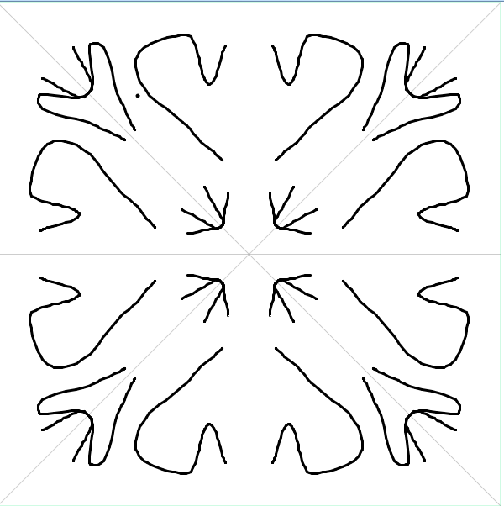
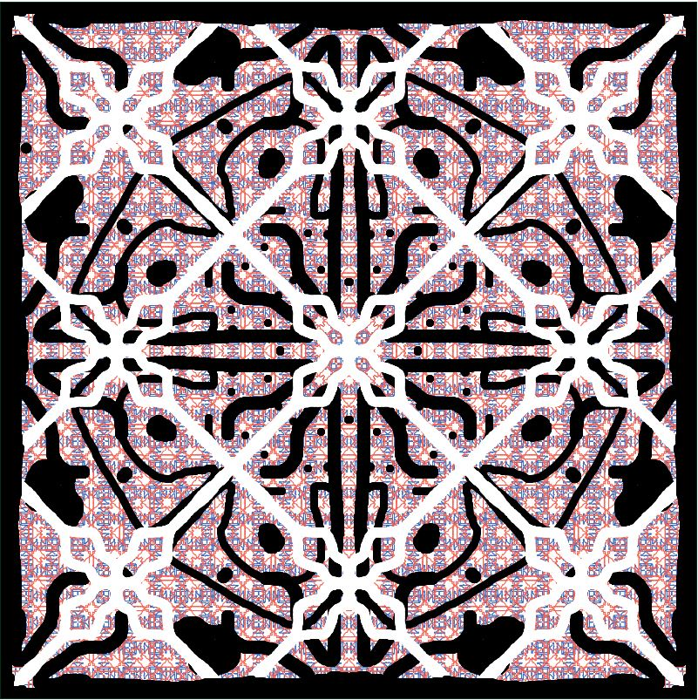
30.09.2020 - Drawing with mirrors
Most of this day I worked on the documentation.
But I also found another interesting take on a mirror drawing map in the online P5 library. I studied that one for quite some while and tried to use it. The patterns are mesmerizing to create. I planned to use the code used to mirroring function in another Project of mine. But it is to advanced for what I try to do. I’ll use the same one I already used for the squares earlier on.

Slide 9
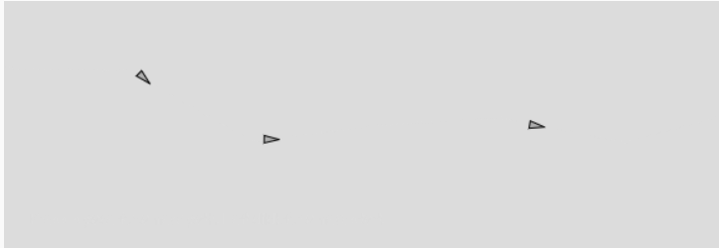
01.10.2020 - Planes and moving again
I gave up on the mirror map and took another look at the online P5 library for inspiration of what to try.
I found this path following script and played around with it for some time.

Slide 10
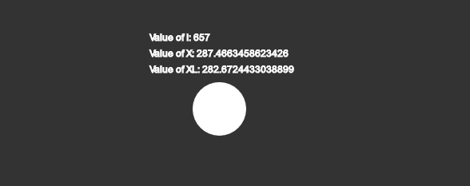
After that timewaster i focused back on one of my original goals of making a Circle move around in a natural manner on the map.
So far this is not successful. The circle is moving in a match to sparastic way and leaves the canvas after some time.
First I did think it was a problem with my laptop and the FPS he can manage. But after some testing it was clear that the way I made the code is the issue.

Slide 11
02.10.2020 - Fixing and restarting
Friday was a bit of a breaking point for me. I realised that I startet different things and none of them came to fruition the way I planned. So I finished them up and put what I got out of them in my documentation.
After fixing some of the Documentation I had a call with Guillaume Massol about my next goal. We talked a bit about mirroring and symmetry. He gave me a link to a book with a lot of input on the topic. I read through it in the afternoon.

Slide 12
07.10.2020 - Lines and Mirror Shapes05
Today I started working on my final Project for this Module with the input i gathered last friday. My goal was to make a mosaic-pattern who is not just repetitive but also symmetric.
First I took the working grid funktion I used for the squares in my Sound02 project. I modified the placement in the squares so that they Mirror each other instead of just copy. For the first approach I used the circle() do to this function only having one X and Y parameter to set.
Not mirrored
Mirrored

Slide 13
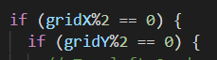

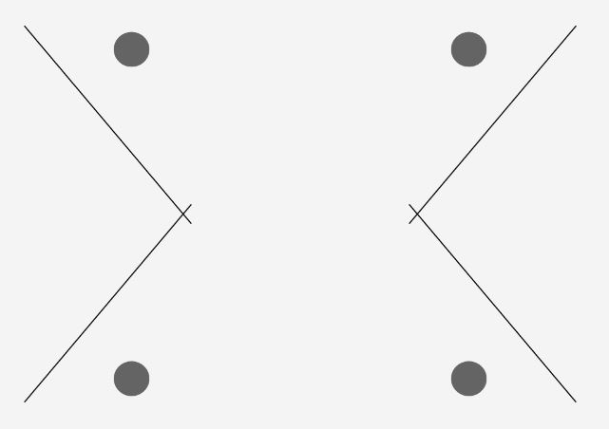
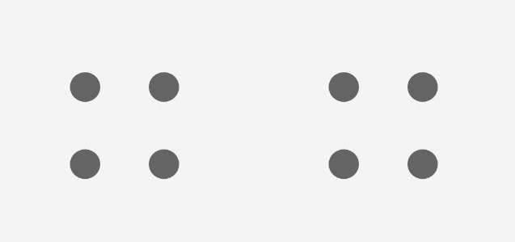
Next up was a line. The tricky part with this was to repeat it. In each of the four quadrants the coordinate of x and y relative to the panel are different.
By counting the grid I was able to give the form the right parameters to rotate around the x- and y-axis.

Slide 14
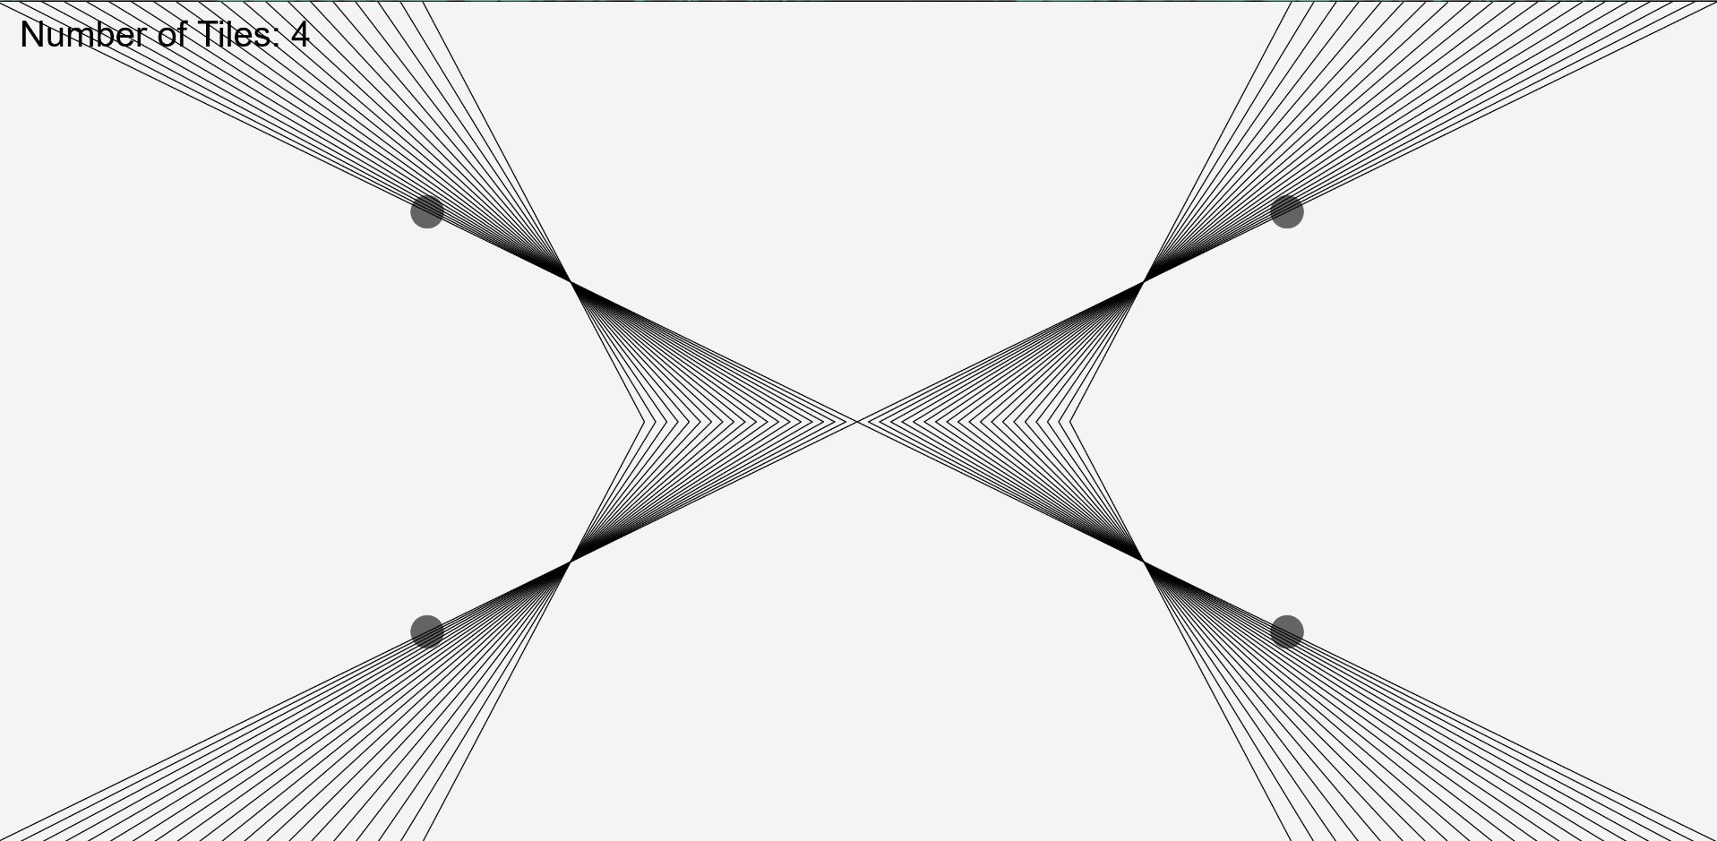
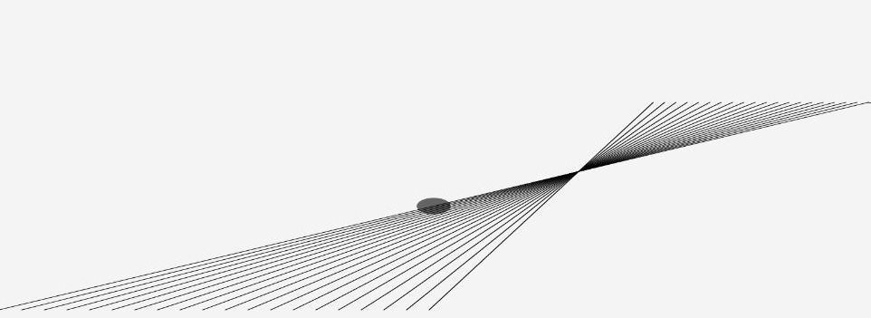
The adding of multiple lanes recursive was the next part.
By dividing up the With and height of the segments I was able to create proportional lines who get mirror nicely on to the next panels.
I played around with this for some time because I made a simple mistake and forgot to set a var correctly in the recursion part of the lines.

Slide 15
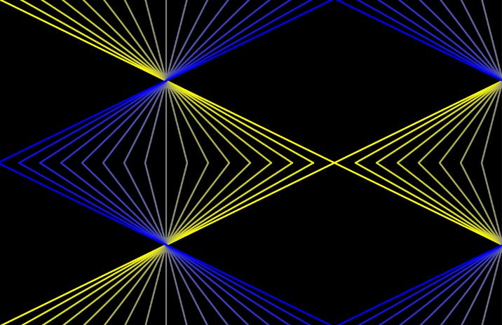
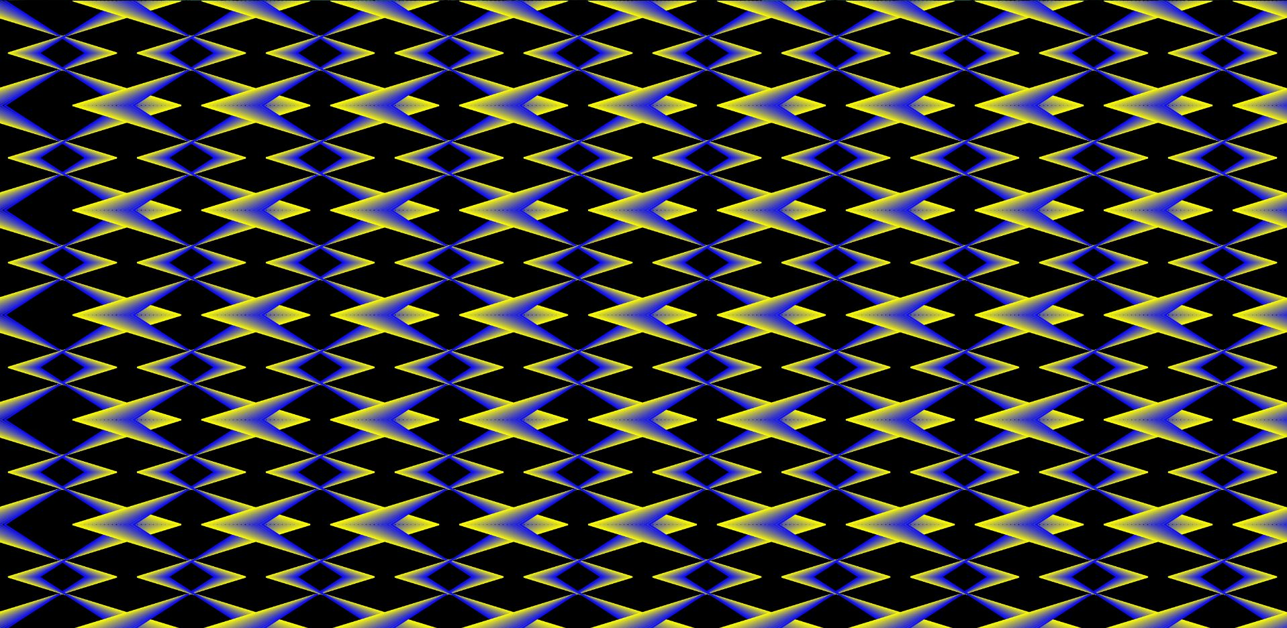
The next step was to make the lines more appealing. First I changed the Background to a near-black colour and gave the lines vibrant ones to make the “pop out” more.
After that I played around with repetition and difference values for the size and position of the lines witch lead to some nice images.

Slide 16
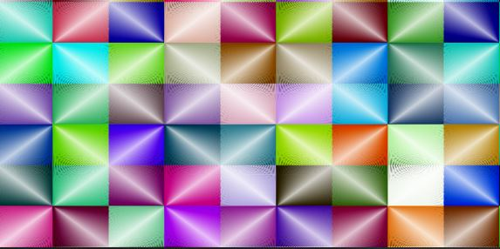
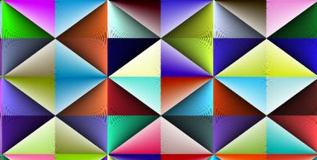
08.10.2020 - Tiles and Patterns Shapes05/06
After trying out different settings on the next day. I found a nice Illusion with adding different shades of black and white at the edges of the lines. This lead to a depth perception on the image.

Slide 17
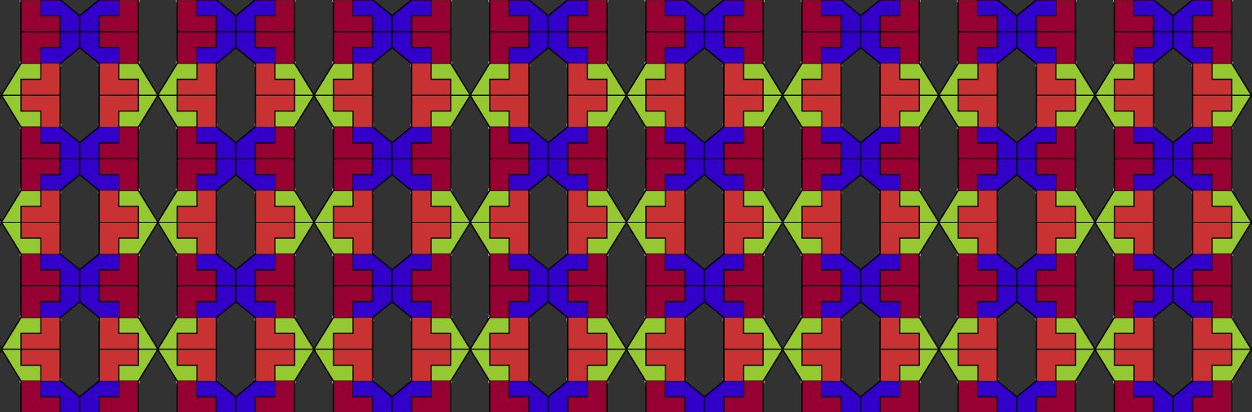
After that I wanted to switch the pasic form I repeat in this sketch. So I moved from lines to shapes and started to create a tiles pattern. This was my goal after all for this part.
The patter I created is with many individual shapes who instead of getting stored and copied to the other tiles, get redraw each time. This leads to a longer load time of the sketch.

Slide 18
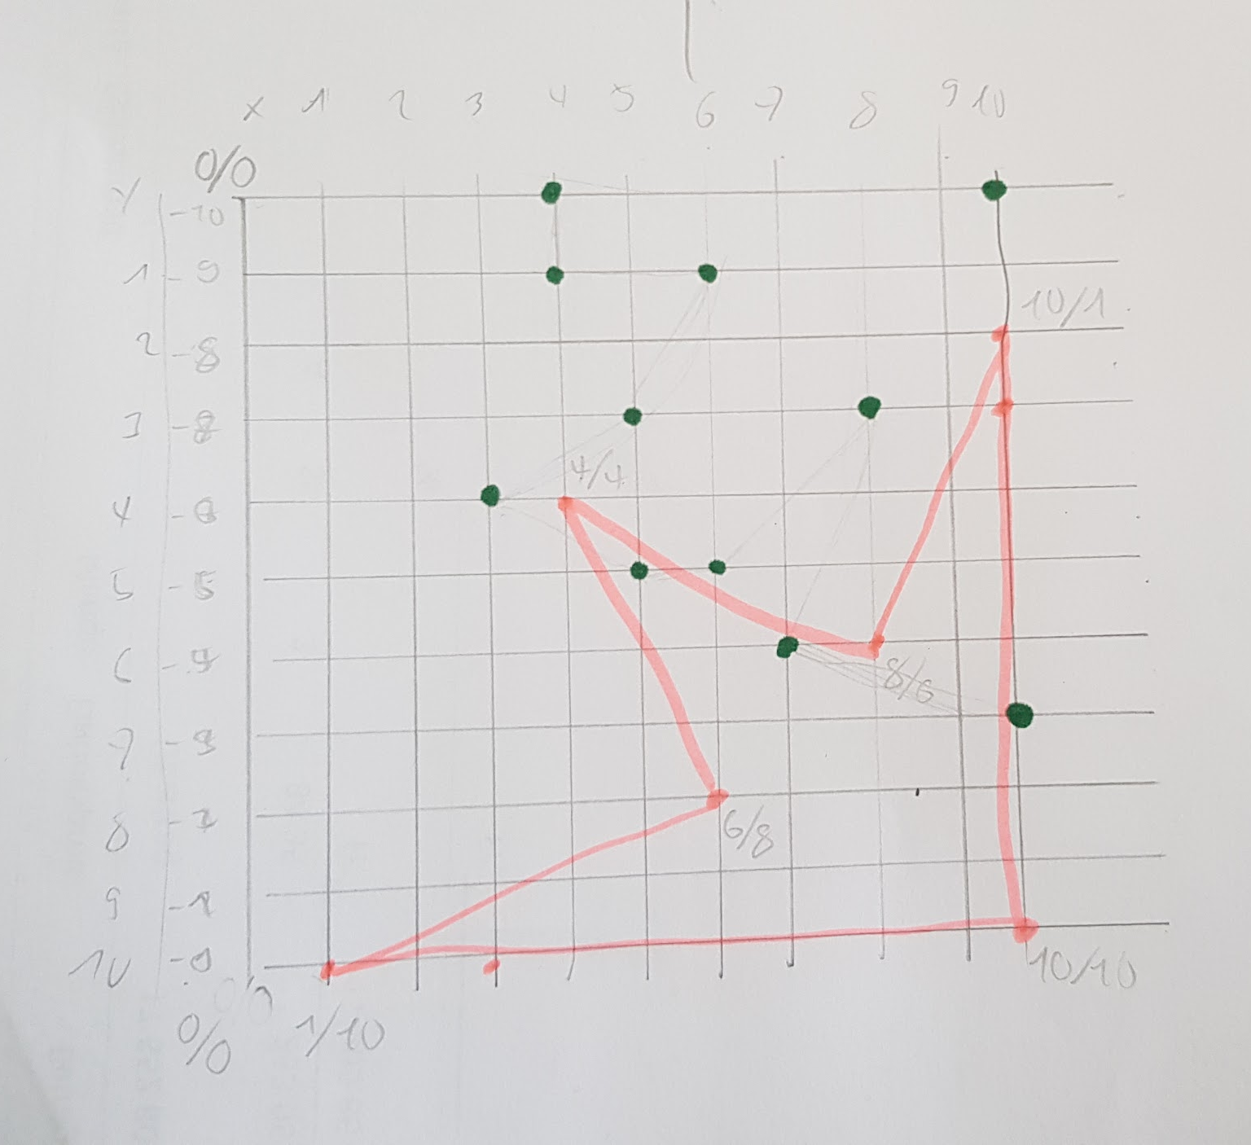
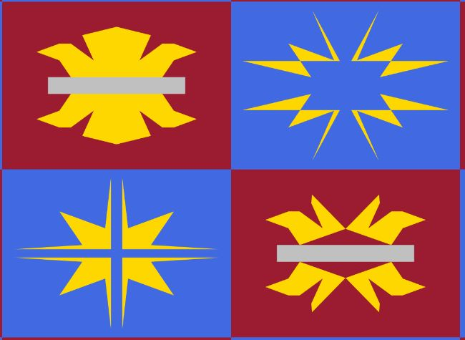
The last evolution for the Sketch06 was after the tiles reminded me of the french coat of arms. I used the shapes in a more free way and added some randomisation in the end.
It took some time to write out all the correct coordinates for the shapes i wanted. Before I just cut the width and height of the tiles into halves or quarters to create the tiles. But for more complex shapes I needed a new raster to work on.

Slide 19
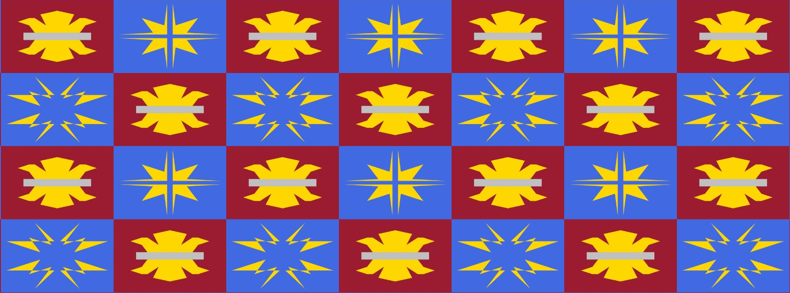
I am happy how the final patter turned out. The randomized stars were simple to add with a simple random number.

